Slide 1
Chapter 15: Query Processing

Slide 2
Outline
Basic Steps in Query Processing
Measures of Query Cost
Selection Operation
Sorting
Join Operation

Slide 3
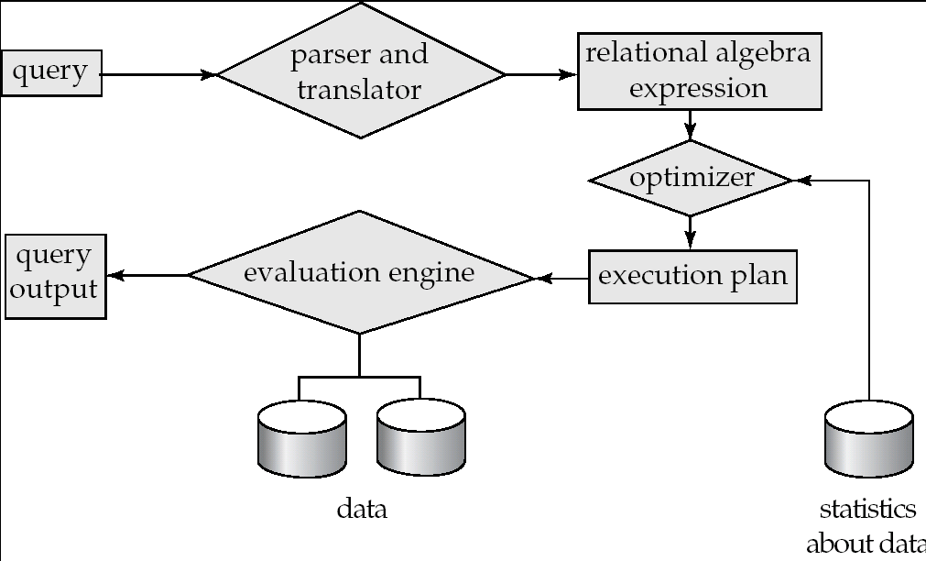
Basic Steps in Query Processing
Parsing and translation
  translate the query into its internal form. This is then translated into relational algebra.
  Parser checks syntax, verifies relations
  Optimization
  Amongst all equivalent evaluation plans choose the one with lowest cost.
Evaluation
  The query-execution engine takes a query-evaluation plan, executes that plan, and returns the answers to the query.

Slide 4

Basic Steps in Query Processing
（Example）
  select name, title
  from instructor natural join (teaches natural join course)
  where dept_name=‘Music’ and year = 2009;
Π_{name, title}(σdept_name= “ Music”∧year = 2009
(instructor (teaches (course))))

Slide 5

Basic Steps in Query Processing
An evaluation plan defines exactly what algorithm is used for each operation, and how the execution of the operations is coordinated.

Slide 6
Viewing Query Evaluation Plans
Most database support explain <query>
  Displays plan chosen by query optimizer, along with cost estimates
  Some syntax variations between databases
    Oracle: explain plan for <query> followed by select * from table (dbms_xplan.display)
    SQL Server: set showplan_text on
Some databases (e.g. PostgreSQL) support explain analyse <query>
  Shows actual runtime statistics found by running the query, in addition to showing the plan
Some databases (e.g. PostgreSQL) show cost as f..l
  f is the cost of delivering first tuple and l is cost of delivering all results

Slide 7
Measures of Query Cost
Cost is generally measured as total elapsed time for answering query
  Many factors contribute to time cost
    disk accesses, CPU, or even network communication
Typically disk access is the predominant cost, and is also relatively easy to estimate.
Measured by taking into account
  Number of seeks * average-seek-cost
  Number of blocks read * average-block-read-cost
  Number of blocks written * average-block-write-cost
    Cost to write a block is greater than cost to read a block
      data is read back after being written to ensure that the write was successful

Slide 8
Measures of Query Cost (Cont.)
For simplicity we just use the number of block transfers from disk and the number of seeks as the cost measures
  t_{T} – time to transfer one block
  t_{S} – time for one seek
  Cost for b block transfers plus S seeks
  b * t_{T} + S * t_{S}
t_{S} and t_{T} depend on where data is stored; with 4 KB blocks:
  High end magnetic disk: t_{S} = 4 msec and t_{T} =0.1 msec, t_{S} / t_{T} ≈ 40
  SSD: t_{S} = 20-90 microsec and t_{T} = 2-10 microsec for 4KB , t_{S} / t_{T} ≈ 10
We ignore CPU costs for simplicity
  Real systems do take CPU cost into account
We ignore cost to writing output to disk in our cost formulae

Slide 9
Measures of Query Cost (Cont.)
Several algorithms can reduce disk IO by using extra buffer space
  Amount of real memory available to buffer depends on other concurrent queries and OS processes, known only during execution
    We often use worst case estimates, assuming only the minimum amount of memory needed for the operation is available
Required data may be buffer resident already, avoiding disk I/O
  But hard to take into account for cost estimation

Slide 10
Selection Operation
File scan
Algorithm A1 (linear search). Scan each file block and test all records to see whether they satisfy the selection condition.
  worst cost = b_{r} * t_{T} + t_{S}
  b_{r} denotes number of blocks containing records from relation r
  If selection is on a key attribute, can stop on finding record
  average cost = (b_{r} /2) t_{T} + t_{S}
  Linear search can be applied regardless of
    selection condition or
    ordering of records in the file, or
    availability of indices
Note: binary search generally does not make sense since data is not stored consecutively
  except when there is an index available,
  and binary search requires more seeks than index search

Slide 11
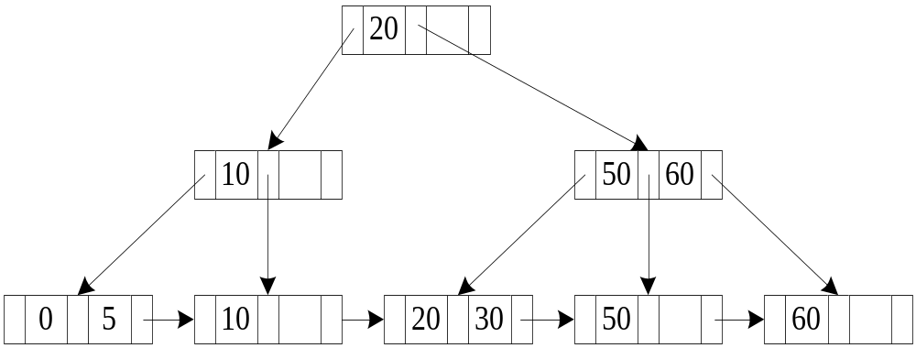
Selections Using Indices
Index scan – search algorithms that use an index
  selection condition must be on search-key of index.
A2 (primary B+-tree index / clustering B+-tree index, equality on key). Retrieve a single record that satisfies the corresponding equality condition
  Cost = (h_{i} + 1) * (t_{T} + t_{S})
0------
5------
10------
20------
30------
50------
。。。
60------

Slide 12
Selections Using Indices
A3 (primary B+-tree index/ clustering B+-tree index, equality on nonkey) Retrieve multiple records.
  Records will be on consecutive blocks
    Let b = number of blocks containing matching records
  Cost = h_{i} * (t_{T} + t_{S}) + t_{S} + t_{T} * b
0------
5------
10------
20------
30------
30------
30------
30------
50------
。。。
60------

Slide 13
Selections Using Indices
A4 (secondary B+-tree index , equality on key) .
  Cost = (h_{i} + 1) * (t_{T} + t_{S})
10------
0------
5------
30------
20------
60------
。。。
50------

Slide 14
Selections Using Indices
A4’ (secondary B+-index on nonkey, equality).
  Each of n matching records may be on a different block
  n pointers may be stored in m blocks
  Cost = (h_{i} + m+ n) * (t_{T} + t_{S})
      Can be very expensive!
10------
0------
5------
30------
20------
30------
60------
50------
30------

Slide 15
Selections Involving Comparisons
Can implement selections of the form σ_{A≤V} (r) or σ_{A ≥ V}(r) by using
  a linear file scan or binary search,
  or by using indices in the following ways:
A5 (primary B+-index / clustering B+-index index, comparison). (Relation is sorted on A)
    For σ_{A ≥ V}(r) use index to find first tuple ≥ v and scan relation sequentially from there.
    Cost is identical to the case of A3 → Cost=h_{i} * (t_{T} + t_{S}) + t_{S} + t_{T} * b
    For σ_{A≤V} (r) just scan relation sequentially till first tuple > v; do not use index
0------
5------
10------
20------
30------
30------
30------
30------
50------
。。。
60------

Slide 16
Selections Involving Comparisons
A6 (secondary B+-tree index, comparison).
    For σ_{A ≥ V}(r) use index to find first index entry ≥ v and scan index sequentially from there, to find pointers to records.
    For σ_{A≤V} (r) just scan leaf pages of index finding pointers to records, till first entry > v
    In either case, retrieve records that are pointed to
      requires an I/O for each record
      Linear file scan may be cheaper
10------
0------
5------
30------
20------
30------
60------
50------
30------

Slide 17
Implementation of Complex Selections
Conjunction: σ_{θ1}∧ _{θ2}∧. . . _{θn}(r)
A7 (conjunctive selection using one index).
  Select a combination of θ_{i} and algorithms A1 through A6 that results in the least cost for σ_{θi} (r).
  Test other conditions on tuple after fetching it into memory buffer.
A8 (conjunctive selection using composite index).
  Use appropriate composite (multiple-key) index if available.
A9 (conjunctive selection by intersection of identifiers).
  Requires indices with record pointers.
  Use corresponding index for each condition, and take intersection of all the obtained sets of record pointers.
  Then fetch records from file
  If some conditions do not have appropriate indices, apply test in memory.

Slide 18
Algorithms for Complex Selections
Disjunction:σ_{θ1}∨ _{θ2} ∨. . . _{θn} (r).
A10 (disjunctive selection by union of identifiers).
  Applicable if all conditions have available indices.
    Otherwise use linear scan.
  Use corresponding index for each condition, and take union of all the obtained sets of record pointers.
  Then fetch records from file
Negation: σ_{¬θ}(r)
  Use linear scan on file
  If very few records satisfy ¬θ, and an index is applicable to θ
    Find satisfying records using index and fetch from file

Slide 19
Sorting
We may build an index on the relation, and then use the index to read the relation in sorted order. May lead to one disk block access for each tuple.
For relations that fit in memory, techniques like quicksort can be used.
For relations that don’t fit in memory,
external sort-merge is a good choice.

Slide 20

Example: External Sorting Using Sort-Merge

Slide 21
External Sort-Merge
Let M denote memory size (in pages).
Create sorted runs(归并段 ).
Let i be 0 initially.
Repeatedly do the following till the end of the relation:
(a) Read M blocks of relation into memory
(b) Sort the in-memory blocks
(c) Write sorted data to run R_{i}; increment i.
Let the final value of i be N

Slide 22
External Sort-Merge (Cont.)
Merge the runs (N-way merge).
IF N < M, single merge pass is required
(如果归并段少于可用内存页)
  Use N blocks of memory to buffer input runs, and 1 block to buffer output. Read the first block of each run into its buffer page
  repeat
    Select the first record (in sort order) among all buffer pages
    Write the record to the output buffer. If the output buffer is full write it to disk.
    Delete the record from its input buffer page.
    If the buffer page becomes empty then
    read the next block (if any) of the run into the buffer.
  until all input buffer pages are empty:
1
3
5
2
4
6
4
output
block
7
9
11
8
10
12
1
2
3
13
15
17
14
16
18
19
21
23
20
22
24
run 1
run 2

Slide 23
External Sort-Merge (Cont.)
If N ≥ M, several merge passes are required.
  In each pass, contiguous groups of M - 1 runs are merged.
  A pass reduces the number of runs by a factor of M -1, and creates runs longer by the same factor.
    E.g. If M=11, and there are 90 runs, one pass reduces the number of runs to 9, each 10 times the size of the initial runs
  Repeated passes are performed till all runs have been merged into one.

Slide 24
External Merge Sort (Cont.)
Cost analysis: (simple version)
  Total number of runs : ⎡br /M⎤.
  Total number of merge passes required: ⎡log _{M–1}(b_{r} /M)⎤.
  Block transfers for initial run creation as well as in each pass is 2b_{r}
    for final pass, we don’t count write cost
      we ignore final write cost for all operations since the output of an operation may be sent to the parent operation without being written to disk
    Thus total number of block transfers for external sorting:
    2b_{r} ⎡log _{M–1} (b_{r} / M)⎤ + b_{r}
    = b_{r} ( 2 ⎡log _{M–1} (b_{r} / M)⎤ + 1)

Slide 25
External Merge Sort (Cont.)
Cost of seeks: (simple version)
  During run generation: one seek to read each run and one seek to write each run
    2 ⎡b_{r} / M⎤ → 2* [the number of runs]
  During the merge phase
    Need 2 b_{r} seeks for each merge pass
      except the final one which does not require a write
    There are ⎡log _{M–1} (br / M)⎤ merger passes
    Total number of seeks:
    2 ⎡b_{r} / M⎤ + b_{r} (2 ⎡log_{M-1}(b_{r} / M)⎤ -1)

Slide 26
External Merge Sort (Cont.)
Cost analysis: (advanced version)
  1 block per run leads to too many seeks during merge
    Instead use b_{b} buffer blocks per run
      ➔ read/write b_{b} blocks at a time
    Can merge ⎣M/b_{b}⎦–1 runs in one pass
  Total number of merge passes required:
  ⎡log _{⎣M/bb⎦–1}(b_{r} /M)⎤.
  Block transfers for initial run creation as well as in each pass is 2b_{r}
    for final pass, we don’t count write cost
      we ignore final write cost for all operations since the output of an operation may be sent to the parent operation without being written to disk
    Thus total number of block transfers for external sorting:
    b_{r} ( 2 ⎡log _{⎣M/bb⎦–1} (b_{r} / M)⎤ + 1)⎤
b_{b} blocks
1
3
5
2
4
6
7
8
9
output
blocks
7
9
11
8
10
12
13
15
17
14
16
18
1
2
3
19
21
23
20
22
24
4
5
6
run 1
run 2

Slide 27
External Merge Sort (Cont.)
Cost of seeks: (advanced version)
  During run generation: one seek to read each run and one seek to write each run
    2 ⎡br / M⎤ → 2* [the number of runs]
  During the merge phase
    Need 2 ⎡br / b_{b}⎤ seeks for each merge pass
      except the final one which does not require a write
    There are ⎡log _{⎣M/ bb ⎦–1} (br / M)⎤ merger passes
    Total number of seeks:
    2 ⎡br / M⎤ + ⎡br / b_{b}⎤ (2 ⎡log_{⎣M/bb⎦–1} (br / M)⎤ -1)

Slide 28
Join Operation
Several different algorithms to implement joins
  Nested-loop join
  Block nested-loop join
  Indexed nested-loop join
  Merge-join
  Hash-join
Choice based on cost estimate
Examples use the following information
  Number of records of student: 5,000 , takes: 10,000
  Number of blocks of student: 100 , takes: 400

Slide 29
Nested-Loop Join
To compute the theta join r _{θ} s
for each tuple t_{r} in r do begin
for each tuple t_{s} in s do begin
test pair (t_{r},t_{s}) to see if they satisfy the
join condition θ
if they do, add t_{r} • t_{s} to the result.
end
end
r is called the outer relation and s the inner relation of the join.
Requires no indices and can be used with any kind of join condition.
Expensive since it examines every pair of tuples in the two relations.
b_{r}
b_{s}
r: outer
s: inner

Slide 30
Nested-Loop Join (Cont.)
In the worst case, if there is enough memory only to hold one block of each relation, the estimated cost is
n_{r} ∗ b_{s} + b_{r} block transfers, plus
n_{r} + b_{r} seeks
If the smaller relation fits entirely in memory, use that as the inner relation.
  Reduces cost to b_{r} + b_{s} block transfers and 2 seeks
Assuming worst case memory availability cost estimate is
  with student as outer relation:
    5000 ∗ 400 + 100 = 2,000,100 block transfers,
    5000 + 100 = 5100 seeks
  with takes as the outer relation
    10000 ∗ 100 + 400 = 1,000,400 block transfers and 10,400 seeks
If smaller relation (student) fits entirely in memory, the cost estimate will be 500 block transfers.
Block nested-loops algorithm (next slide) is preferable.

Slide 31
Block Nested-Loop Join
Variant of nested-loop join in which every block of inner relation is paired with every block of outer relation.
for each block B_{r} of r do begin
for each block B_{s} of s do begin
for each tuple t_{r} in B_{r} do begin
for each tuple t_{s} in B_{s} do begin
Check if (t_{r},t_{s}) satisfy the join condition
if they do, add t_{r} • t_{s} to the result.
end
end
end
end
b_{r}
b_{s}
r: outer
s: inner

Slide 32
Block Nested-Loop Join (Cont.)
Worst case estimate: b_{r} ∗ b_{s} + b_{r} block transfers + 2 * b_{r} seeks
  Each block in the inner relation s is read once for each block in the outer relation
Best case: b_{r} + b_{s} block transfers + 2 seeks.

Slide 33
Block Nested-Loop Join (Cont.)
Improvements to block nested loop algorithms:
  Use M-2 disk blocks as blocking unit for outer relations, where M = memory size in blocks; use remaining two blocks to buffer inner relation and output
    Cost = ⎡b_{r} / (M-2)⎤ ∗ b_{s} + b_{r} block transfers
    + 2 ⎡b_{r} / (M-2)⎤ seeks
    If r fits in memory (b_{r}<=M-2),
    Cost = b_{s} + b_{r} block transfers + 2 seeks
  If equi-join attribute forms a key on the inner relation, stop inner loop on first match
  Scan inner loop forward and backward alternately, to make use of the blocks remaining in buffer (with LRU replacement)
M-2
1
1
M
b_{r}
b_{s}
s: inner
r: outer

Slide 34
Indexed Nested-Loop Join
Index lookups can replace file scans if
  join is an equi-join or natural join and
  an index is available on the inner relation’s join attribute
    Can construct an index just to compute a join.
For each tuple t_{r} in the outer relation r, use the index to look up tuples in s that satisfy the join condition with tuple t_{r}.
Worst case: buffer has space for only one page of r, and, for each tuple in r, we perform an index lookup on s.
Cost of the join: b_{r} (t_{T} + t_{S}) + n_{r} ∗ c
  Where c is the cost of traversing index and fetching all matching s tuples for one tuple or r
  c can be estimated as cost of a single selection on s using the join condition.
If indices are available on join attributes of both r and s,
use the relation with fewer tuples as the outer relation.

Slide 35
Example of Nested-Loop Join Costs
Compute student takes, with student as the outer relation.
Let takes have a primary B⁺-tree index on the attribute ID, which contains 20 entries in each index node.
Since takes has 10,000 tuples, the height of the tree is 4, and one more access is needed to find the actual data
student has 5000 tuples，stored in 100 blocks.
Cost of block nested loops join
  400*100 + 100 = 40,100 block transfers
  + 2 * 100 = 200 seeks
    assuming worst case memory
    may be significantly less with more memory
Cost of indexed nested loops join
  100 + 5000 * 5 = 25,100 block transfers and seeks.
  CPU cost likely to be less than that for block nested loops join

Slide 36

Merge-Join
Sort both relations on their join attribute (if not already sorted on the join attributes).
Merge the sorted relations to join them
  Join step is similar to the merge stage of the sort-merge algorithm.
  Main difference is handling of duplicate values in join attribute — every pair with same value on join attribute must be matched
  Detailed algorithm in book

Slide 37
Merge-Join (Cont.)
Can be used only for equi-joins and natural joins
Each block needs to be read only once (assuming all tuples for any given value of the join attributes fit in memory
Thus the cost of merge join is:
b_{r} + b_{s} block transfers +
⎡b_{r} / b_{b}⎤ + ⎡b_{s} / b_{b}⎤ seeks
  + the cost of sorting if relations are unsorted.
b_{b} blocks
1
3
3
1
1
2
4
5
5
3
4
5
8
9
9
6
7
7
10
10
11
8
8
9
br
bs

Slide 38
Merge-Join (Cont.)
If the buffer memory size is M pages, in order to minimize the cost of merge join, how to assign M blocks to r and s respectively?
The estimated cost is
b_{r} + b_{s} block transfers +
⎡b_{r} / x_{r}⎤ + ⎡b_{s} / x_{s}⎤ seeks
(x_{r} + x_{s} = M)
Answer:
x_{r}= √ b_{r} * M/（√ b_{r} + √ b_{s})
x_{s}= √ b_{s}* M/（√ b_{r} + √ b_{s})
1
1
2
x_{r} blocks
1
3
3
1
1
2
x_{s} blocks
4
5
5
3
4
5
8
9
9
6
7
7
10
10
11
8
8
9
br
bs

Slide 39
Merge-Join (Cont.)
hybrid merge-join: If one relation is sorted, and the other has a secondary B⁺-tree index on the join attribute
  Merge the sorted relation with the leaf entries of the B⁺-tree .
  Sort the result on the addresses of the unsorted relation’s tuples
  Scan the unsorted relation in physical address order and merge with previous result, to replace addresses by the actual tuples
    Sequential scan more efficient than random lookup

Slide 40

Hash-Join
Applicable for equi-joins and natural joins.
A hash function h is used to partition tuples of both relations with common JoinAttrs
h maps JoinAttrs values to {0, 1, ..., n},
  r₀, r₁, . . ., r_{n} denote partitions of r tuples
    Each tuple t_{r} ∈ r is put in partition r_{i} where
    i = h(t_{r} [JoinAttrs]).
  s₀,, s₁. . ., s_{n} denotes partitions of s tuples
    Each tuple t_{s} ∈s is put in partition s_{i}, where
    i = h(t_{s} [JoinAttrs]).
    Note： the value n and the hash function h is chosen such that each s_{i} should fit in memory.
  n >= ⎡b_{s} / M⎤
Note: In book, r_{i} is denoted as H_{ri,} s_{i} is denoted as H_{si} and n is denoted as n_{h.}
.should fit in memory!
.in-memory hash index
h(t_{r}[JoinAttrs])
h(t_{s} [JoinAttrs])
build input
probe input

Slide 41
Hash-Join (Cont.)
r tuples in r_{i} need only to be compared with s tuples in s_{i} Need not be compared with s tuples in any other partition, since:
  an r tuple and an s tuple that satisfy the join condition will have the same value for the join attributes.
  If that value is hashed to some value i, the r tuple has to be in r_{i} and the s tuple in s_{i}.

Slide 42
Hash-Join Algorithm
The hash-join of r and s is computed as follows.
Partition s using hashing function h. When partitioning a relation, one block of memory is reserved as the output buffer for each partition.
Partition r similarly.
For each i:
  (a) Load s_{i} into memory and build an in-memory hash index on it using the join attribute. This hash index uses a different hash function than the earlier one h.
  (b) Read the tuples in r_{i} from the disk one by one. For each tuple t_{r} locate each matching tuple t_{s} in s_{i} using the in-memory hash index. Output the concatenation of their attributes.
Relation s is called the build input
Relation r is called the probe input

Slide 43
Hash-Join algorithm (Cont.)
The value n and the hash function h is chosen such that each build input relation partitions s_{i} should fit in memory.
  Typically n is chosen as ⎡b_{s}/M⎤ * f where f is a “fudge factor(修正因子)”, typically around 1.2
The probe input relation partitions ri need not fit in memory

Slide 44
Recursive partitioning
Recursive partitioning required if number of partitions n is greater than number of pages M of memory.
  Instead of partitioning n ways, use M – 1 partitions for s
  Further partition the M – 1 partitions using a different hash function
  Use same partitioning method on r
  A relation does not need recursive partitioning if M > n_{h} + 1, or equivalently M > (b_{s}/M) + 1, which simplifies (approximately) to M > √b_{s}.
  For example, consider a memory size of 12M bytes, divided into 4K bytes blocks; it would contain a total of 3K (3072) blocks. We can use a memory of this size to partition relations of size up to 3K ∗ 3K blocks, which is 36G (3K ∗ 3K ∗ 4K ) bytes.
  Similarly, a relation of size 1 gigabyte requires just over √256K blocks, or 2 megabytes, to avoid recursive partitioning.

Slide 45
Cost of Hash-Join
If recursive partitioning is not required: cost of hash join is
3(b_{r} + b_{s}) +4 ∗ n_{h} block transfers +
2( ⎡b_{r} / b_{b}⎤ + ⎡b_{s} / b_{b}⎤) ⁺ 2 ∗ n_{h} seeks
  Block transfers : The partitioning of the two relations r and s calls for a complete reading of both relations, and a subsequent writing back of them. This operation requires 2(b_{r} + b_{s}) block transfers. The build and probe phases read each of the partitions once, calling for further b_{r} +b_{s} block transfers. The number of blocks occupied by partitions could be slightly more than br +bs, as a result of partially filled blocks. Accessing such partially filled blocks can add an overhead of at most 2n_{h} for each of the relations, since each of the n_{h} partitions could have a partially filled block that has to be written and read back. Thus, a hash join is estimated to require: 3(b_{r} + b_{s}) + 4n_{h} block transfers .
  Seeks: Assuming b_{b} blocks are allocated for the input buffer and each output buffer, partitioning requires a total of 2(_x0007_b_{r} /b_{b} +_x0007_b_{s}/b_{b} ) seeks. The build and probe phases require only one seek for each of the n_{h} partitions of each relation, since each partition can be read sequentially. The hash join thus requires 2(b_{r} /b_{b} +b_{s}/b_{b} ) + 2n_{h} seeks.

Slide 46
Cost of Hash-Join
If recursive partitioning required:
  number of passes required for partitioning build relation s to less than M blocks per partition is ⎡log_{⎣M/bb⎦–1}(b_{s}/M)⎤
  best to choose the smaller relation as the build relation.
  Total cost estimate is:
  2(b_{r} + b_{s}) ⎡log_{⎣M/bb⎦–1}(b_{s}/M)⎤ + b_{r} + b_{s} block transfers +
  2(⎡b_{r} / b_{b}⎤ + ⎡b_{s} / b_{b}⎤) ⎡log_{⎣M/bb⎦–1}(b_{s}/M) ⎤ seeks
If the entire build input can be kept in main memory no partitioning is required
  Cost estimate goes down to b_{r} + b_{s}.

Slide 47
Example of Cost of Hash-Join
instructor teaches
Assume that memory size is 20 blocks
b_{instructor}= 100 and b_{teaches} = 400.
instructor is to be used as build input. Partition it into five partitions, each of size 20 blocks. This partitioning can be done in one pass.
Similarly, partition teaches into five partitions,each of size 80. This is also done in one pass.
Therefore total cost, ignoring cost of writing partially filled blocks:
  3(100 + 400) = 1500 block transfers +
  2( ⎡100/3⎤ + ⎡400/3⎤)+2*5 =336 +10seeks=346 seeks

Slide 48
Complex Joins
Join with a conjunctive condition:
r _{θ1∧ θ 2∧... ∧ θ n} s
  Either use nested loops/block nested loops, or
  Compute the result of one of the simpler joins r _{θi} s
    final result comprises those tuples in the intermediate result that satisfy the remaining conditions
  θ₁ ∧ . . . ∧ θ_{i –1} ∧ θ_{i +1} ∧ . . . ∧ θ_{n}
Join with a disjunctive condition
  r _{θ1 ∨ θ2 ∨... ∨ θn} s
  Either use nested loops/block nested loops, or
  Compute as the union of the records in individual joins r _{θ i} s:
  (r _{θ1} s) ∪ (r _{θ2} s) ∪ . . . ∪ (r _{θn} s)

Slide 49
Semijoin Operation
Design an algorithm for Semijoin Operation r ⋉ _{θ} s .
r ⋉ θ s: if a tuple r_{i} appears （n times） in r, it appears （n times） in the result of r ⋉ _{θ} s , if there is at least one tuple s_{i} in s matching with r_{i} under the condition θ.
Candidate Algorithms
  Block nested-loop join
  Indexed nested-loop join
  Merge-join
  Hash-join
  ……
  Estimated the cost of the algorithm.

